Slide 1
Audit Survey Results 2014
Summary
Total Surveys Submitted: 79
Total Surveys Sent: 310
Average Score: 4.17 out of 5
Standard Deviation: 1.04
Response Rate: 79 / 310 - 25.48%
All negative survey results (Rate 1 or 2) have been addressed individually with related auditors.
We suggest to make the auditee aware of the survey during the closing meeting.

Slide 2
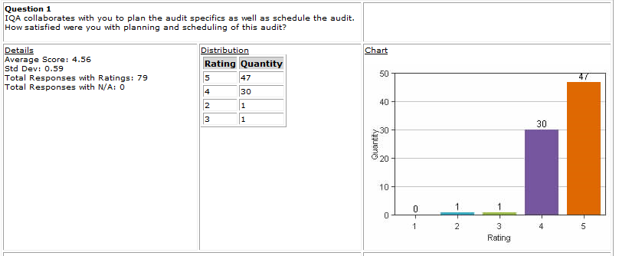
Audit Survey Results 2014 Question 1

Slide 3
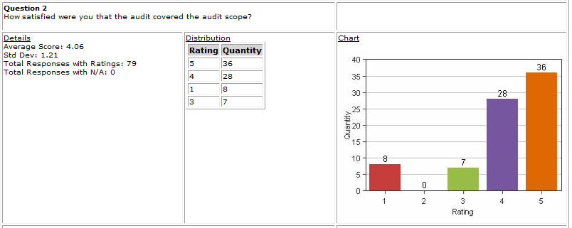
Audit Survey Results 2014 Question 2

Slide 4
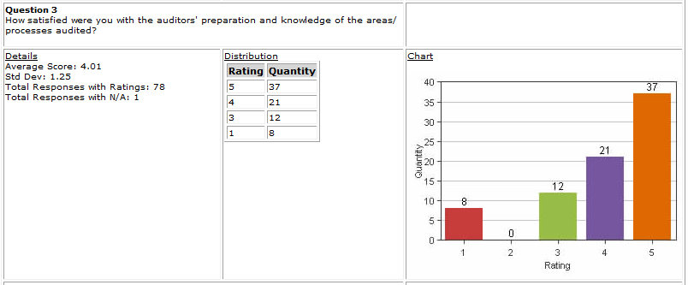
Audit Survey Results 2014 Question 3

Slide 5
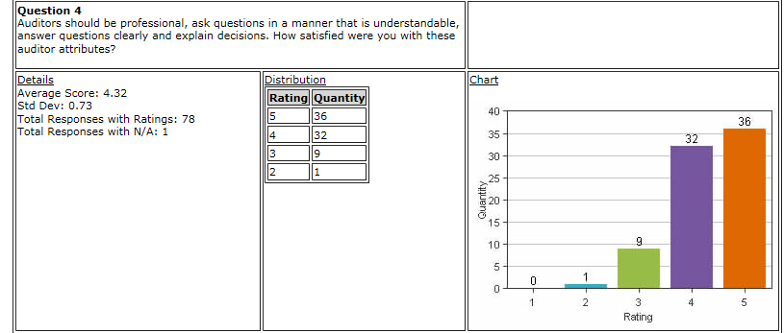
Audit Survey Results 2014 Question 4

Slide 6
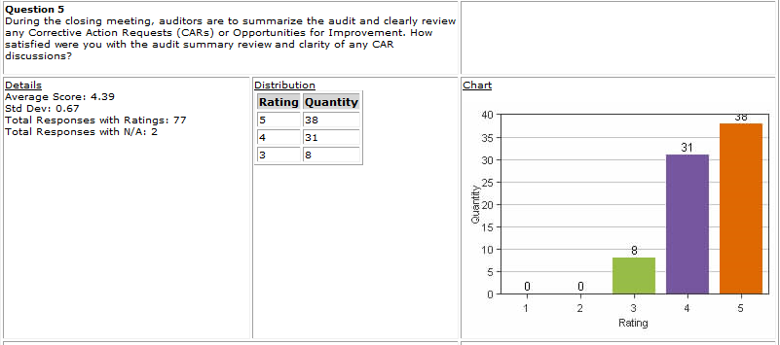
Audit Survey Results 2014 Question 5

Slide 7
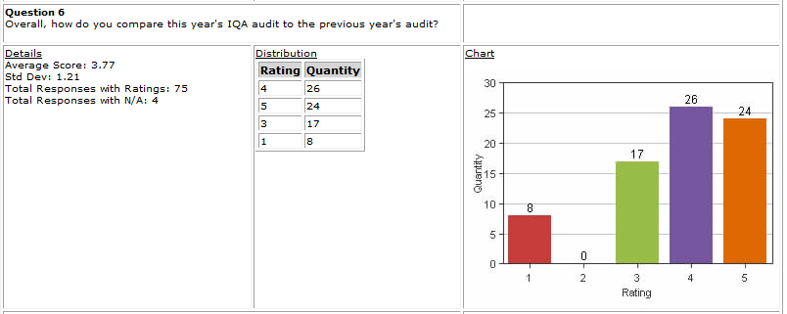
Audit Survey Results 2014 Question 6

Slide 8
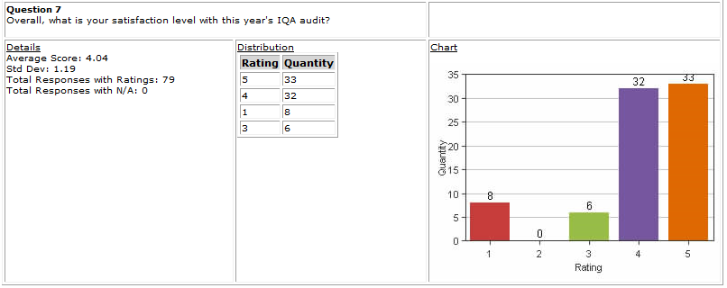
Audit Survey Results 2014 Question 7

Slide 9
Audit Survey Results 2014 Sample of Good Comments
I am inspired by the positive feedback from the local staff & managers. I believe that this reflects very highly on the three auditors. This is exactly the approach to audits that will change the face of Quality within UL from being seen as police to being partners. ( Julianne, Mel and Jennifer Murrill)
First class. Both 2013 and 2014 audits, the depth and knowledge due to background preparation is clear to all. Even experienced staff in particular field share that the value they can experience from the Internal Quality is high level. (Kyle)
Well in advance notice, plenty of time to be prepared (Alan)
The Auditor did an excellent job taking the time to explain each of the CAR and why they were CARs. (Mark)
Nice work with preparations and the unexpected situation. Great team! (Tovia and Jim ) With Mark out unexpectedly, Tovia stepped up and revised the audit schedule quickly. Audit went very smoothly due to the efforts of the team.
Actually, auditor suggested to us many things of best practice based on his technical knowledge and experiences. I'm happy to work with him. (Mel)

Slide 10
Audit Survey Results 2014 Improvement Opportunity from Survey
Question 6:
Overall, how do you compare this year's IQA audit to the previous year's audit?
This question will be deleted from Survey in 2015 based on the feedback from the comments below and the survey results in 2014.
“Suggest you change this question or the available answers. Is the intention that I am rating how this audit compared to last year's (better, same, worse)?”

Slide 11
Audit Survey Results 2014 Improvement Opportunity from Survey
Scheme document audit will not include CPO oversight in the audit scope any more.
Scheme document audit was piloted for programs managed in UL Demko in 2014. Based on the comments below, the scheme document audit will focus on the documentation only. There will be no actual fulfilment activities reviewed, including CPO oversight, since the oversight requirement does not exist any more.
“OFI: More clear focus on this audit is a requirement/policy audit of CPO and not a process/execution audit of the CO - still questions in regards to how the CO are fulfilling the requirements.”

Slide 12
Audit Survey Results 2014 Improvement Opportunity from Survey
Following Comments are for open discussion:
“NIST HB 150 and 150-17 were briefly covered. Would prefer to cover HB 150/150-17 in more detail as that is what the external auditors cover.”
“Consideration could be given to collaborating with L2, L3 or L4 engineers to assess the technical aspects of the tests.”
“it appeared that we spent a lot of time in the beginning of the meetings clarifying the objective. Maybe we could do more pre- work before the actual audit so folks know what to prepare. “

Slide 13
Audit Survey Results 2014 Improvement Opportunity from Survey
Following Comments are for open discussion:
“There were CARs written around the same item (PQA) that could have been combined into one CAR”
“Mark Steinke was not available during the first 3 days of the audit due to another conflict. He did some pre-work the previous week, including visual exam of samples in the lab and asking clarifying questions of lab managers regarding items that appeared to be nonconformance. It would have been helpful if Mark had notified the lab managers in advance.”

